Slide 1


Slide 2

Database Management Systems
Shamim Ahmad

Slide 3
Overview
Course Title: Database Management Systems
Course Code: CSE 3103
Course Type: Theory
Credits: 3
Prerequisite Knowledge: Discrete Mathematics
Year and Semester: 3rd Year, Summer Semester, 2025

Slide 4
Instructor’s details:
Name: Dr. Shamim Ahmad
Designation: Professor
Web: www.ru.ac.bd/cse
Office Room: First Floor, East Block
Email: shamim_cst@yahoo.com
Cell phone: 01713140107

Slide 5



Slide 6


Shamim Ahmad’s
Profile Page
at
Rajshahi University
www.ru.ac.bd

Slide 7

Zoom (PMI 427 888 6753)

Slide 8

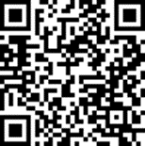

Slide 9


Slide 10
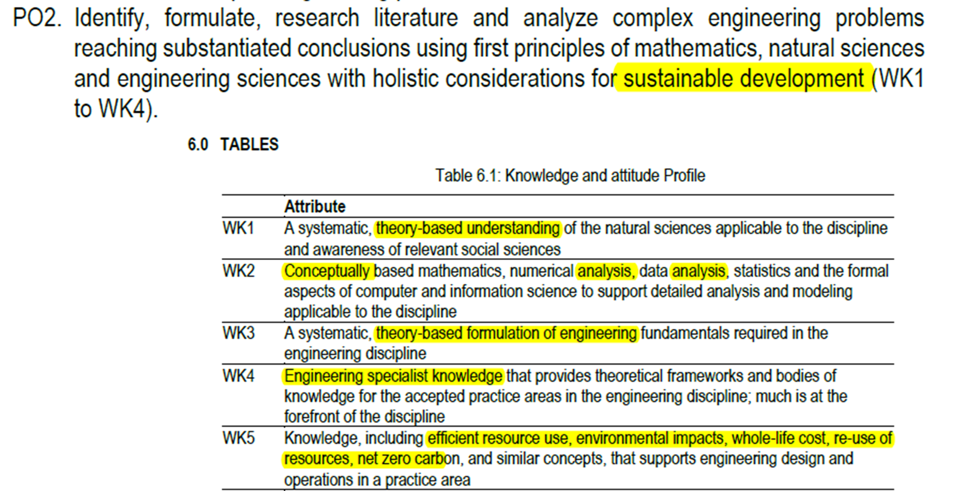

Slide 11
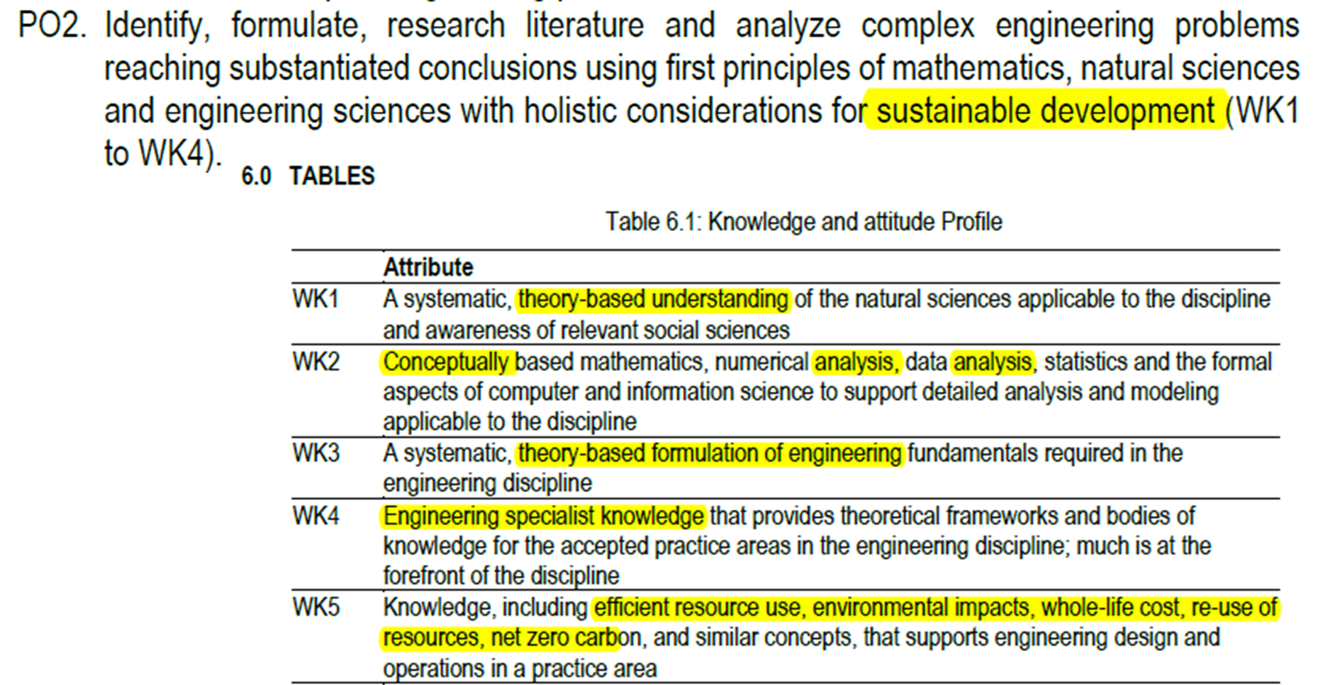

Slide 12
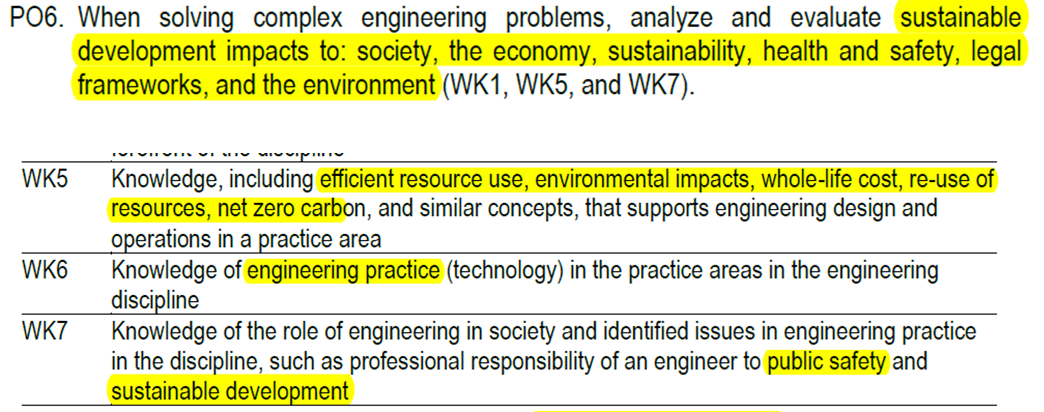

Slide 13
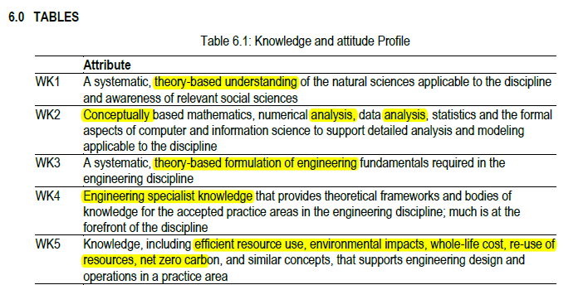
Knowledge Profile (K1–K9)

Slide 14
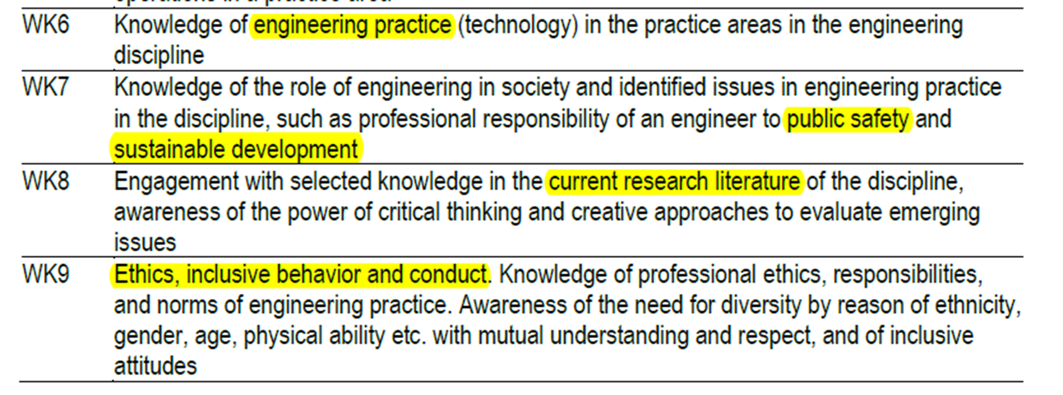
Knowledge Profile (K1–K9)

Slide 15
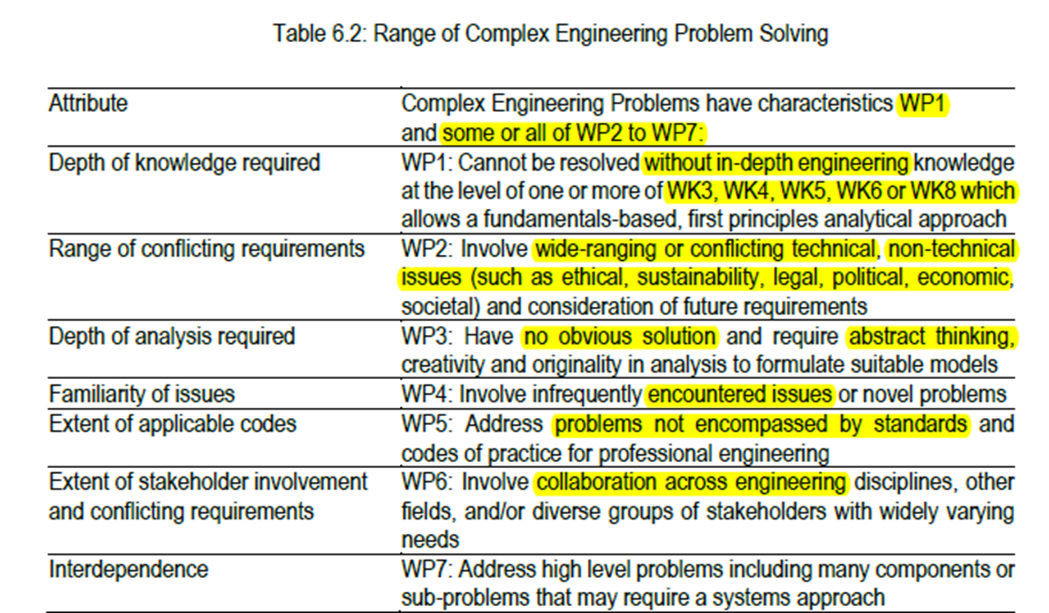

Slide 16
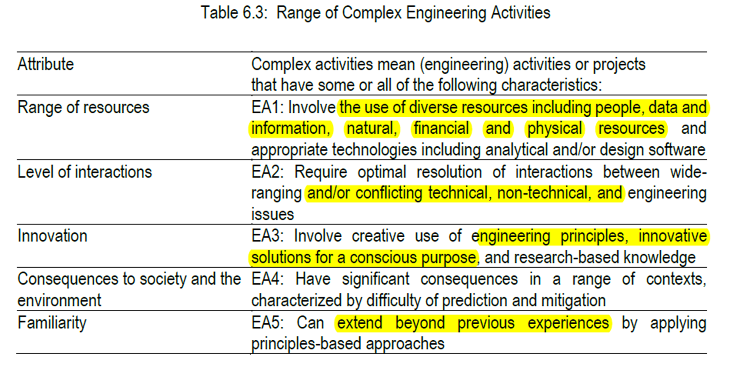

Slide 17
Teaching Learning Method

Slide 18
Sessions | Topics | Readings | CO
Week-1 | Introduction and Database system concept | A. Silberschatz, Database System Concepts pp 1-23 PowerPoint slides | CO!
Week-2 | Entity-Relationship Model | A. Silberschatz, Database System Concepts pp 27-68 PowerPoint slides | CO1, CO2
Week-3 | Entity-Relationship Model | A. Silberschatz, Database System Concepts pp 27-68 PowerPoint slides | CO1, CO2, CO3
Week-4 | Relational Model, Relational algebra, structure of MySQL | A. Silberschatz, Database System Concepts pp 80-118 PowerPoint slides | CO1, CO2, CO3
Week-5 | Relational Model, Relational algebra, structure of MySQL | A. Silberschatz, Database System Concepts pp 80-118 PowerPoint slides | CO1, CO2, CO3
Week-6 | Relational Model, Relational algebra, structure of MySQL | A. Silberschatz, Database System Concepts pp 80-118 PowerPoint slides | CO2, CO3
Week-7 | Mid Term Examination and Class Test |  | CO2
Week-8 | Integrity and Security, Reverent MySQL Structure | A. Silberschatz, Database System Concepts pp 226-246 | CO1, C)2,
Week-9 | Relational-Database Design, Functional dependencies and normal forms | A. Silberschatz, Database System Concepts pp 256*-293 PowerPoint slides | CO2, CO3
Week-10 | Relational-Database Design, Functional dependencies and normal forms | A. Silberschatz, Database System Concepts pp 256*-293 PowerPoint slides | CO2, CO3
Week-11 | Storage and File Structure, RAID | A. Silberschatz, Database System Concepts pp 394-410 PowerPoint slides | CO1
Week-12 | Transactions, ACID Properties, Schedule | A. Silberschatz, Database System Concepts pp 566-583 PowerPoint slides | CO1
Week-13 | Concurrency Control, Recovery System Relevant MySQL Structure | A. Silberschatz, Database System Concepts pp 591-598, 640-651 PowerPoint slides | CO1, CO2, CO3
Week-14 | Reviews, Class Test and Final Exam |  | CO3

Slide 19
Assessment Tools

Slide 20
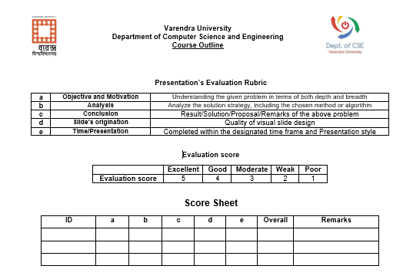

Slide 21
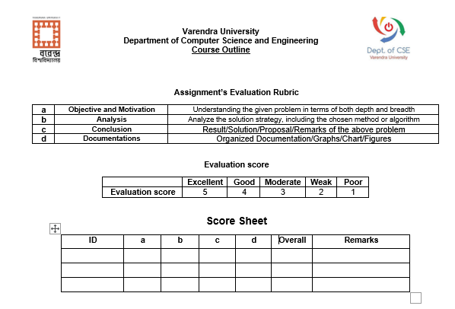

Slide 22


Slide 23
Week-1 | Introduction and Database system concept | A. Silberschatz, Database System Concepts pp 1-23 PowerPoint slides
Week-2 | Entity-Relationship Model | A. Silberschatz, Database System Concepts pp 27-68 PowerPoint slides
Week-3 | Entity-Relationship Model | A. Silberschatz, Database System Concepts pp 27-68 PowerPoint slides
Week-4 | Relational Model, Relational algebra, structure of MySQL | A. Silberschatz, Database System Concepts pp 80-118 PowerPoint slides

Slide 24
Week-5 | Relational Model, Relational algebra, structure of MySQL | A. Silberschatz, Database System Concepts pp 80-118 PowerPoint slides
Week-6 | Relational Model, Relational algebra, structure of MySQL | A. Silberschatz, Database System Concepts pp 80-118 PowerPoint slides
Week-7 | Mid Term Examination and Class Test
Week-8 | Integrity and Security, Reverent MySQL Structure | A. Silberschatz, Database System Concepts pp 226-246
Week-9 | Relational-Database Design, Functional dependencies and normal forms | A. Silberschatz, Database System Concepts pp 256*-293 PowerPoint slides

Slide 25
Week-10 | Relational-Database Design, Functional dependencies and normal forms | A. Silberschatz, Database System Concepts pp 256*-293 PowerPoint slides
Week-11 | Storage and File Structure, RAID | A. Silberschatz, Database System Concepts pp 394-410 PowerPoint slides
Week-12 | Transactions, ACID Properties, Schedule | A. Silberschatz, Database System Concepts pp 566-583 PowerPoint slides
Week-13 | Concurrency Control, Recovery System Relevant MySQL Structure | A. Silberschatz, Database System Concepts pp 591-598, 640-651 PowerPoint slides
Week-14 | Reviews, Class Test and Final Exam

Slide 26

Course Conducting/Course Policies:
4.The students must enter the classroom in time to get the attendance. No student will be allowed to enter the classroom after the attendance has been done.

Slide 27

Course Conducting/Course Policies:
5.Once the attendance is done, a student can leave the class if he or she thinks that he or she is not getting benefits from the class
6.The date and syllabus of quiz/class test will be announced in time in google classroom.

Slide 28
Course Conducting/Course Policies:
6. The date and syllabus of quiz/class test will be announced in time in google
classroom.
7. The reading materials for each class will be available at the above given link prior to that class so that student may have a cursory look into the materials.
8. Students will be notified in due time for class cancelation, extra class, make-up class and tutorial class.

Slide 29

Course Conducting/Course Policies:
9. Students are encouraged to participate in the class discussion and to ask questions. The student can ask any question without any hesitation as long as he or she can’t understand the topics being discussed; please keep in mind that if you don’t understand, it’s not your fault, it’s my limitation that I could not make you understand. The class is expected to be interactive
10.Each student will have to present an oral presentation

Slide 30

Course Conducting/Course Policies:
11. It is expected that the student will also provide some new knowledge related to the curriculum and then make the class as a place of knowledge sharing among all participants, both teacher and students.

Slide 31


Course Conducting/
Course Policies:
12. Any attempt for unfairmeans in the examination is strictly prohibited.

Slide 32
Additional Information

Slide 33

Lab Course Contents/List of Experiments:
1. Installation of MySQL
2. Create database and table, Table operation (Alter/Drop etc)
3. Create table with integrated constraints (Primary key, Foreign Key)
4. Insert/delete/update SQL Query (with condition)
5. Join, Select Query with multiple conditions and from multiple Tables/Relations
6. String searching and operation
7. Trigger
8. Authorization granting
9. Concurrent processing

Slide 34

A project report must be submitted according to the following format:
1. Project Title, Student(s) name and ID with department name & RU logo
2. Introduction
3.Background, Motivation and Objectives
4. Design requirements
5.ER diagram, DFD
6.Key selection, Table formation
7.Introducing Constraint and Integrity
8.Normalization
9.Ensuring concurrent operations
10.implementation by MySQL
11.References

Slide 35


